Slide 1
Basics of Measurement
Chad Williams
University of Victoria

Slide 2
Lecture Outline
Structure of Statistics
Research Design
Numbers
Scales of Measurement

Slide 3
Lecture Outline
Structure of Statistics
Research Design
Numbers
Scales of Measurement

Slide 4
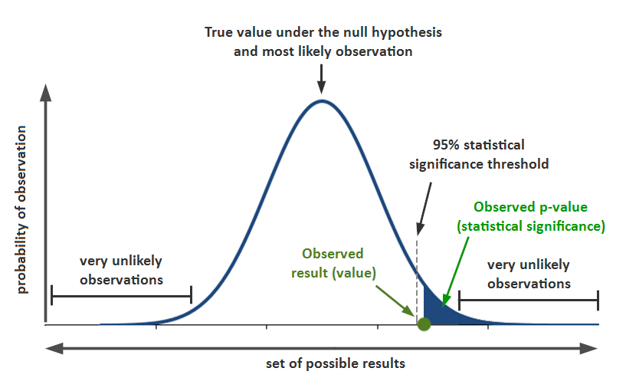
Types of Statistics
Two Main Types:
Null Hypothesis Significance Testing (NHST)
Focuses on p-value thresholds
Bayesian Statistics
Data driven approach to statistics

Slide 5
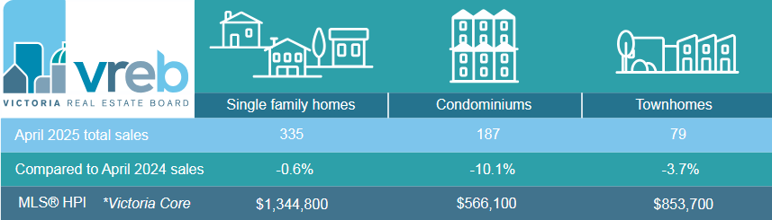
Types of NHST Statistics
Descriptive Statistics: Defines a set of data using metrics
Organizes and summarizes

Slide 6
Types of NHST Statistics
Inferential Statistics: Compares two or more things to determine if they are the same or different
Objective procedure

Slide 7
Lecture Outline
Structure of Statistics
Research Design
Numbers
Scales of Measurement

Slide 8
Y-Axis (Dependent Variable)
X-Axis (Independent Variable)

Slide 9

Research Design
Independent Variable (IV): Feature of research used to explain participants’ behaviour
Often called the predictor or X
Can be manipulated or measured

Slide 10
Research Design
Independent Variable (IV)
Manipulated: The experimenter explicitly changes conditions
E.g., Studying in a loud room vs quiet room

Slide 11
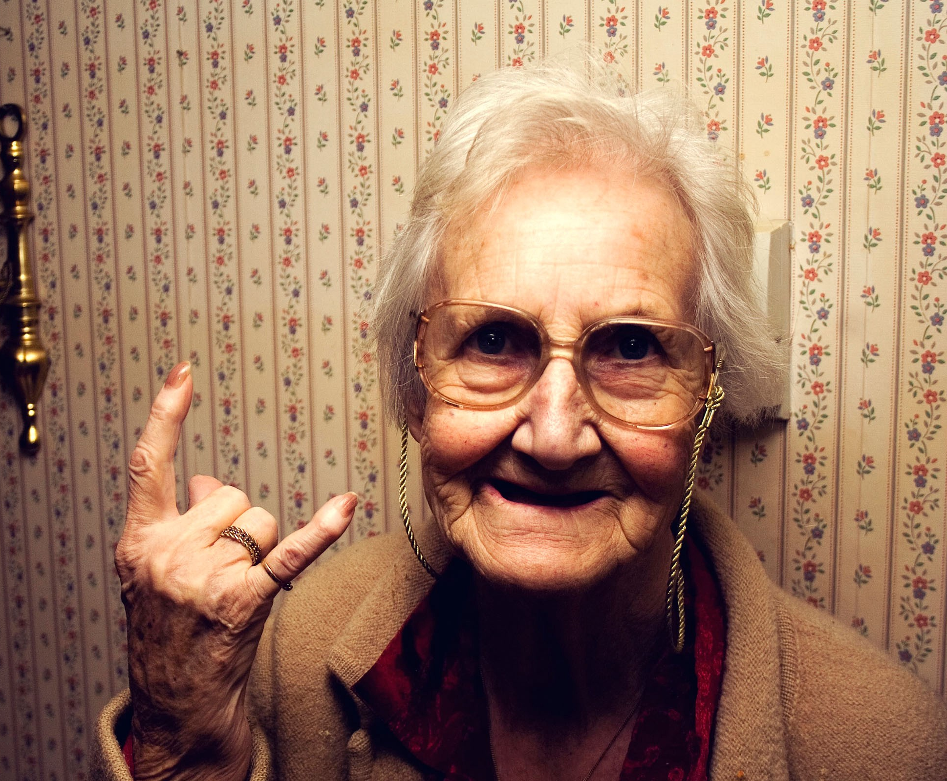
Research Design
Independent Variable (IV)
Measured: The experimenter finds participants that already fit conditions
E.g., Young vs old participants

Slide 12
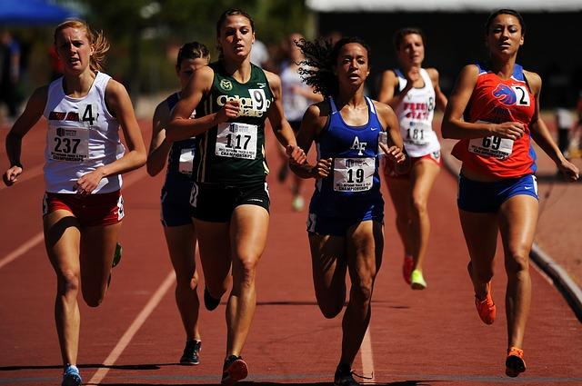
Research Design
Dependent Variable (DV): Number that represents a measure of participant behaviour
Often called the criterion or Y
These are the values we will use
in computations
E.g., time in ms to complete a race

Slide 13
Y-Axis (Dependent Variable)
X-Axis (Independent Variable)

Slide 14
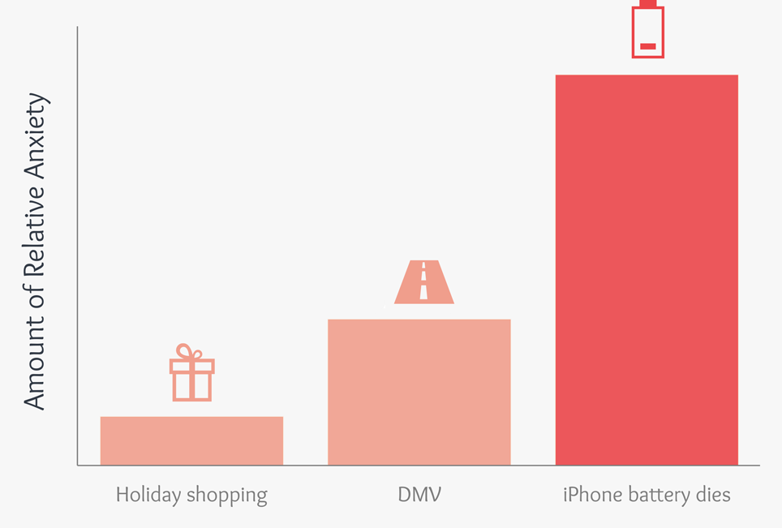
Research Design

Slide 15

Research Design
Research Design: A structured plan to investigate a research question
Research Question: The question a study aims to answer
I want to see if there is a difference in height between basketball players and soccer players
I want to know whether cats believe they disappear when they close their eyes

Slide 16
Research Design
Operational Definitions: A precise description of how something is being measured
E.g., Reaction time will be measured in milliseconds
Reaction time will be measured in milliseconds from the start buzzer until the racer completely passes the finish line

Slide 17
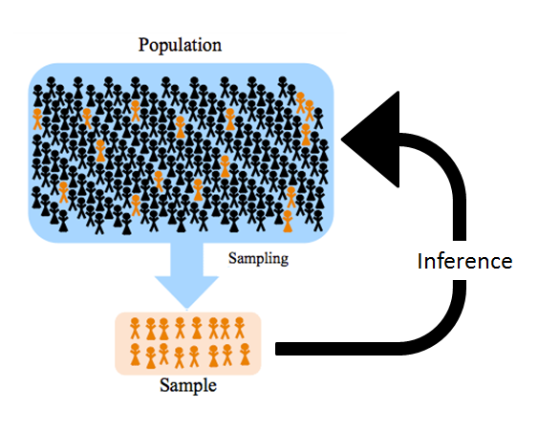
Population and Sample
Population: Set of all individuals of interest
The students in this class
Canadians
Humans

Slide 18
Population and Sample
Sample: Set of individuals selected from population to represent the population
10 students randomly chosen
Any Canadian that answered my phone call
Any human that signed up for my study online

Slide 19
Population and Sample
Sampling Error: Discrepancy (error) between sample and population
Samples must represent population for us to generalize to population
e.g., If you measure the height of all UVic students but by chance mostly recruit basketball players

Slide 20
Lecture Outline
Structure of Statistics
Research Design
Numbers
Scales of Measurement

Slide 21
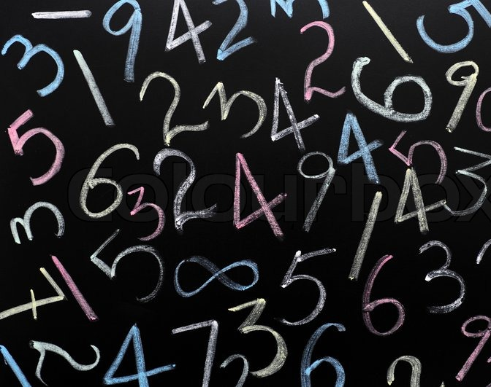
Numerals vs Numbers
Numerals: Symbolic classification or code
Has qualitative meaning
e.g., Birthplace: Canada, United States, China…
OR 1 = Canada, 2 = United States, 3 = China…
Numbers: Symbolic measurement
Has quantitative meaning
e.g., Height: 5’2”, 6’0”, 4’11”

Slide 22

Numbers
Measurement: Is the act of assigning a number or numeral to an attribute or property of an object, organism, or event according to specific rules

Slide 23
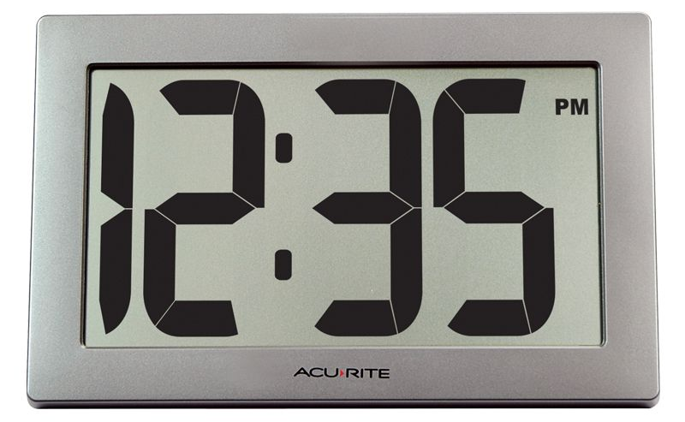
Numbers
Discrete Numbers: Property or characteristic of a variable
No possible values in between
E.g., Number of students
in this class

Slide 24
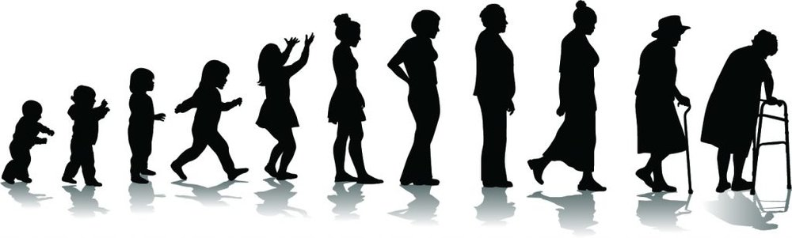
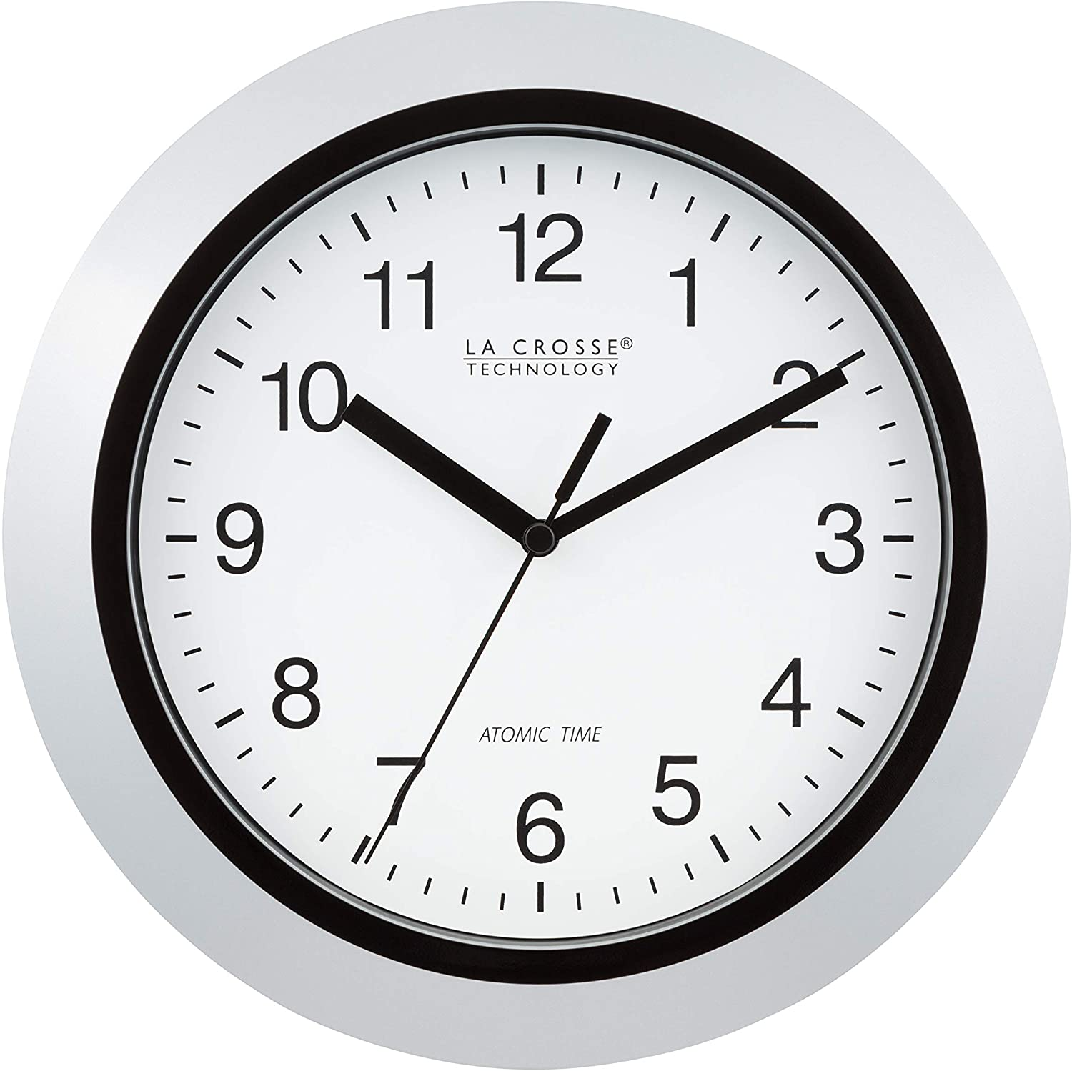
Numbers
Continuous Numbers: Numbers that have either finite or infinite number of values
Can have values in between
E.g., age

Slide 25
Numbers
Discrete Continuum: A discrete scale with underlying continuous measure
E.g., age can be young or old
The underlying scale could be 0 to 50 years old is young and 51 to 100 years old is old

Slide 26

Datum and Data
Datum: A single observed value
Depicted as X_{O}
Chad received 85%
Data: Multiple observed values
Depicted as X values
The students received 85%, 72%, 98%...

Slide 27
Measurement Error
X_{O} = X_{t} + X_{e}
_{What we measured =}
What we tried to measure + how bad we messed up
_{Observed = True Score + Error}

Slide 28
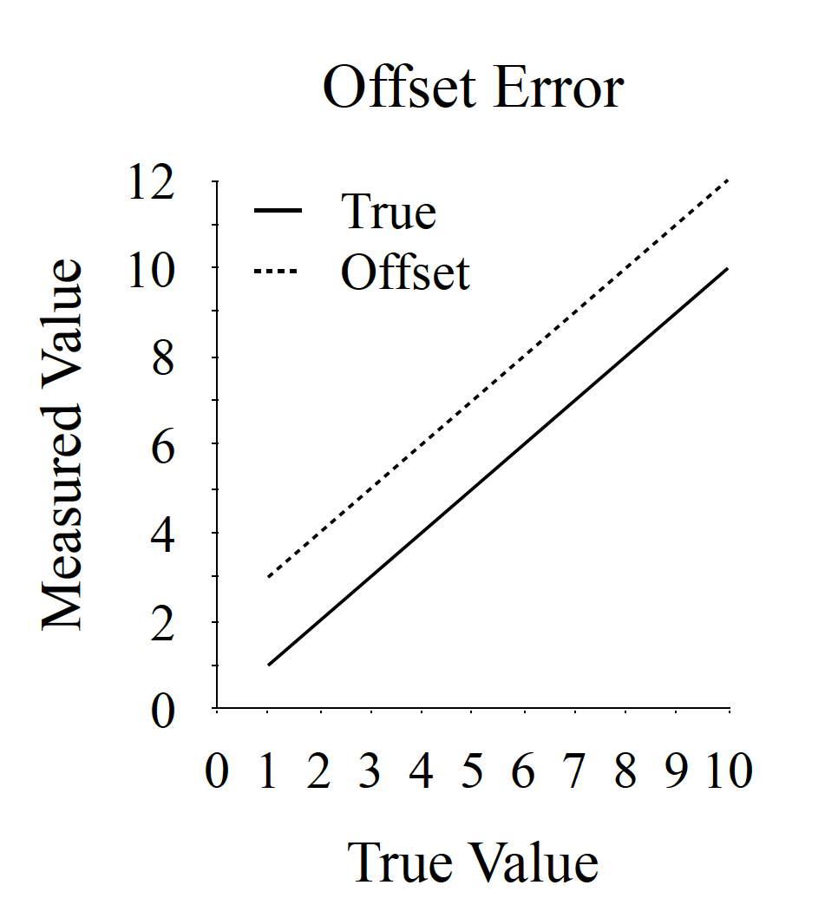
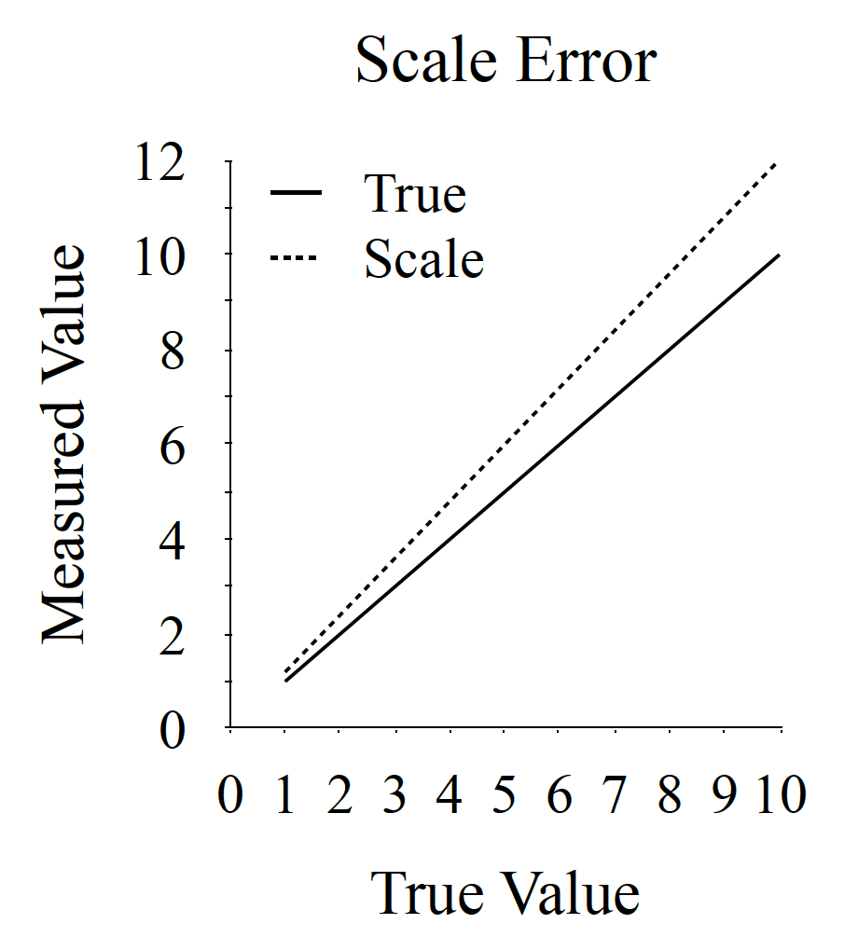
Measurement Error
Measurement Error: When we over or underestimate a true value
Systematic Error: An error that is consistent and repeatable
Offset Errors: There is a fixed error that is the same across all values being measured
E.g., the scale plate is heavier than it’s supposed to be
Scale Errors: When there is an error that is proportional to the values being measured
E.g., weak spring on scale

Slide 29
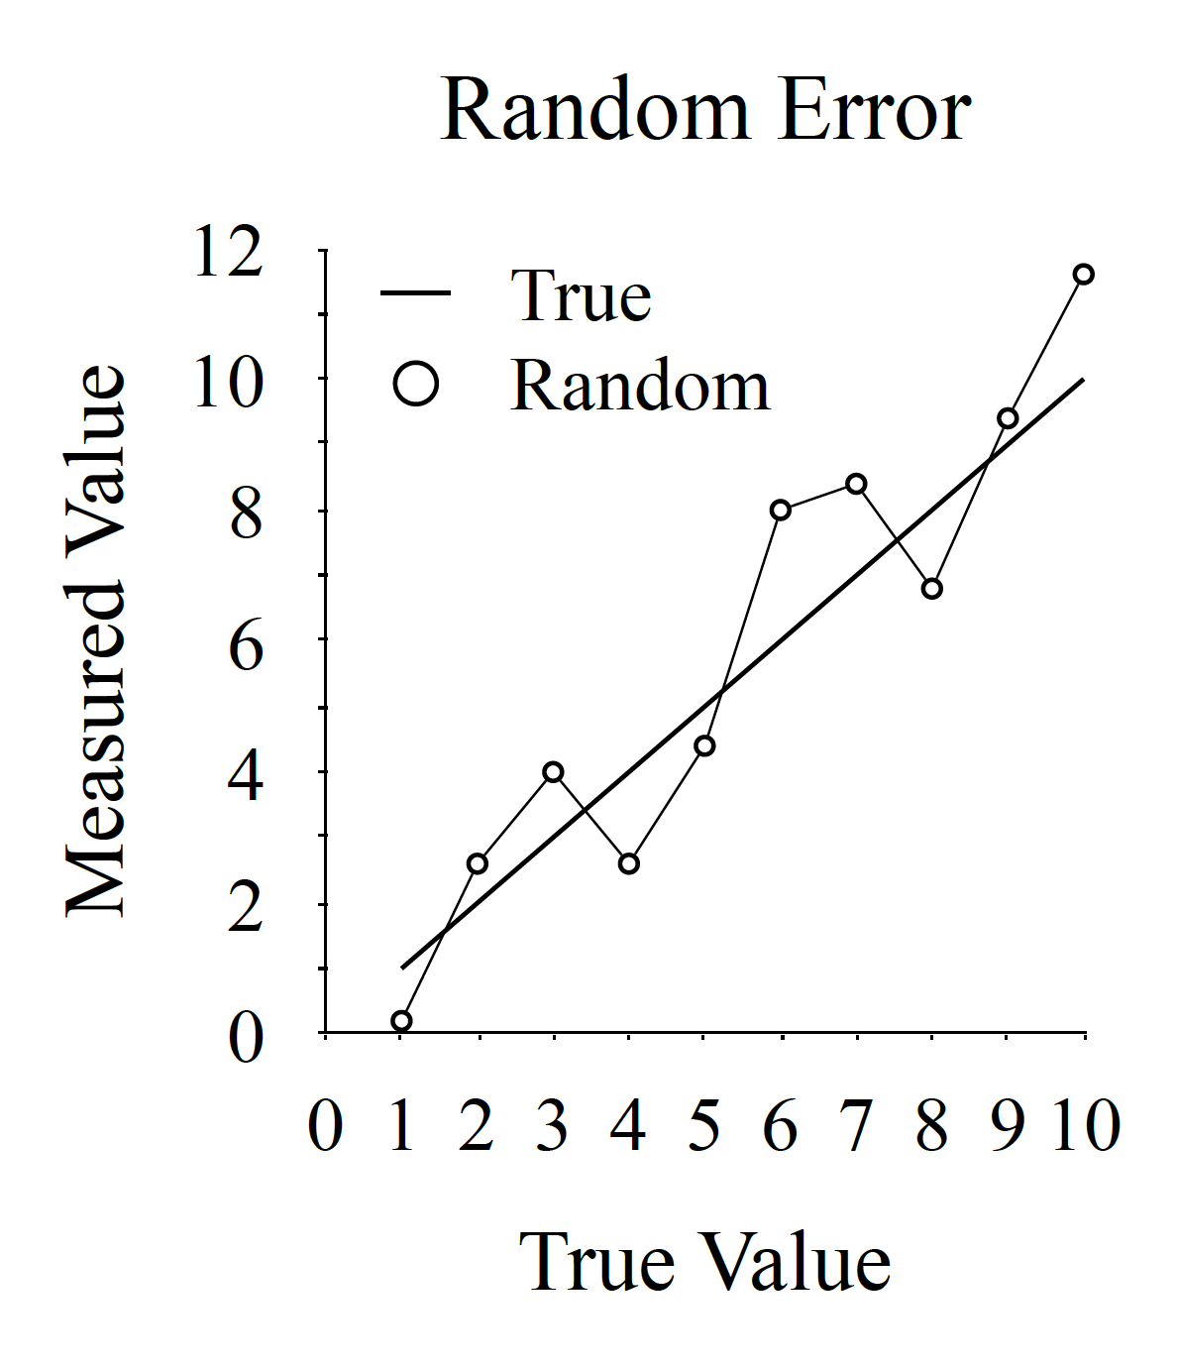
Measurement Error
Measurement Error
Random Error: An error without any consistent pattern
Random errors average over participants/measures
E.g., experimenter error

Slide 30
Lecture Outline
Structure of Statistics
Research Design
Numbers
Scales of Measurement

Slide 31

Scales of Measurement
Four different types of data:
Nominal
Ordinal
Interval
Ratio
These types of data determine which statistical tests we use

Slide 32
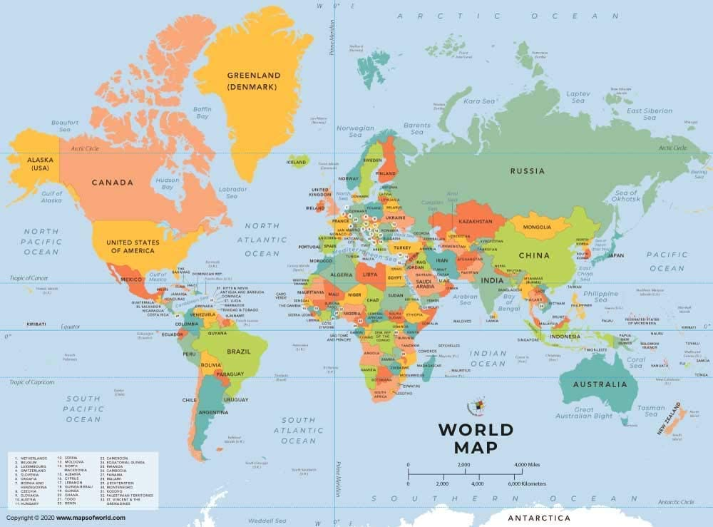
Scales of Measurement
E.g., Birthplace
Qualitative
Each category is distinct
There is no order to the categories
Measure by counting how many participants responded per category
Nominal Scale: Categorical representations

Slide 33

Scales of Measurement
Ordinal Scale: Rank-ordered measure
E.g., Olympic medals
Qualitative
Each rank is distinct
There exists a relative order
No information about distance
between ranks

Slide 34

Scales of Measurement
Interval Scale: Measure with meaningfully equal distances
E.g., Temperature in Celsius
Quantitative
There exists meaningful order
Distance between each value is equal
Does not have meaningful zero
i.e., absence of measure
Thus, cannot claim proportions
10°C is not twice as hot as 5°C

Slide 35

Scales of Measurement
Ratio Scale: Measure with meaningfully equal distances
E.g., salary
Quantitative
There exists meaningful order
Distance between each value is equal
There exists a true zero
i.e., an absence of measure
Thus, can claim proportions
60 is twice as old as 30

Slide 36
Scales of Measurement
Well-Standardized Scales: A survey that has been carefully assessed and produces consistent, comparable, and reliable results
E.g., PHQ-9 (Depression survey)
Likert scales are considered an ordinal scale
However, if they are well-standardized, they are instead treated as an interval scale
Strongly Disagree | Disagree | Undecided | Agree | Strongly Agree
1 | 2 | 3 | 4 | 5

Slide 37
Scale | Order of values known | Can quantify the difference between each value | Can add or subtract values | Compute ratio | Has a “true zero” | Examples
Nominal | No | No | No | No | No | Nationality, eye colour, marital status
Ordinal | Yes | No | No | No | No | Letter grades, SES, clothing size
Interval | Yes | Yes | Yes | No | No | °C, date, IQ scores
Ratio | Yes | Yes | Yes | Yes | Yes | Percentage grade, salary, height, length

Slide 38
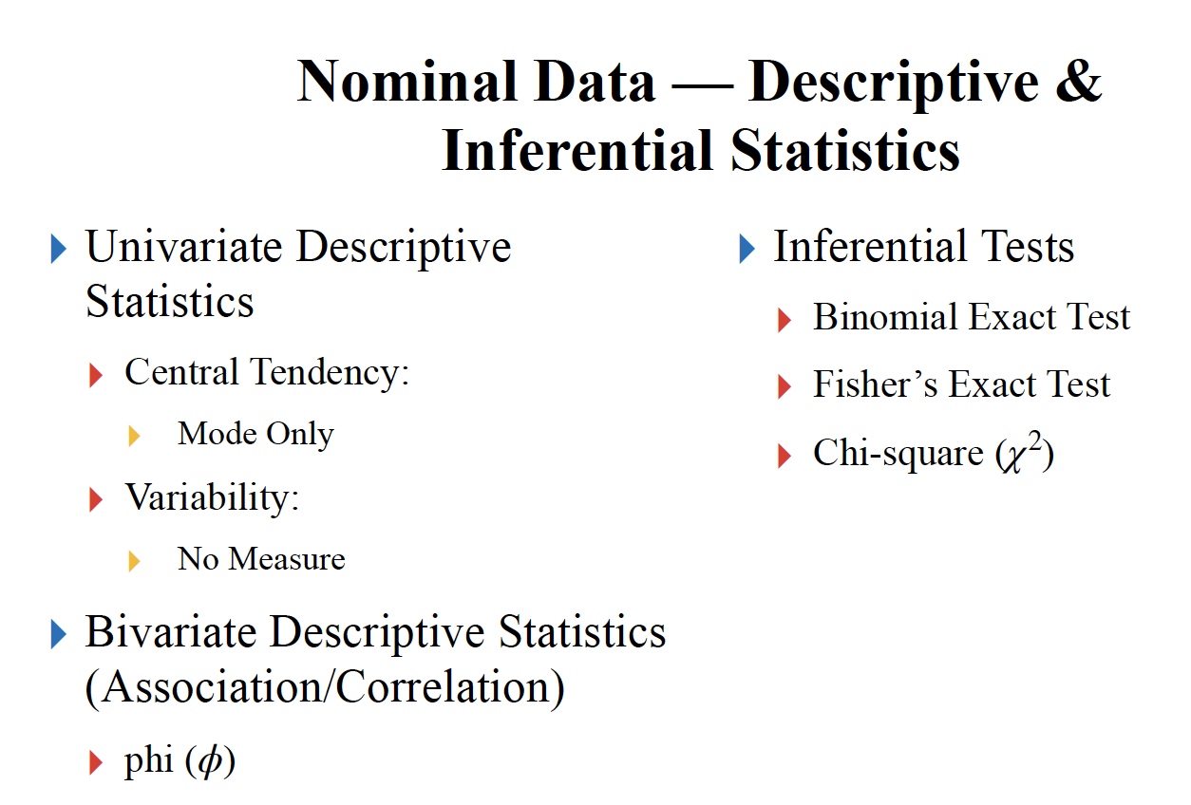
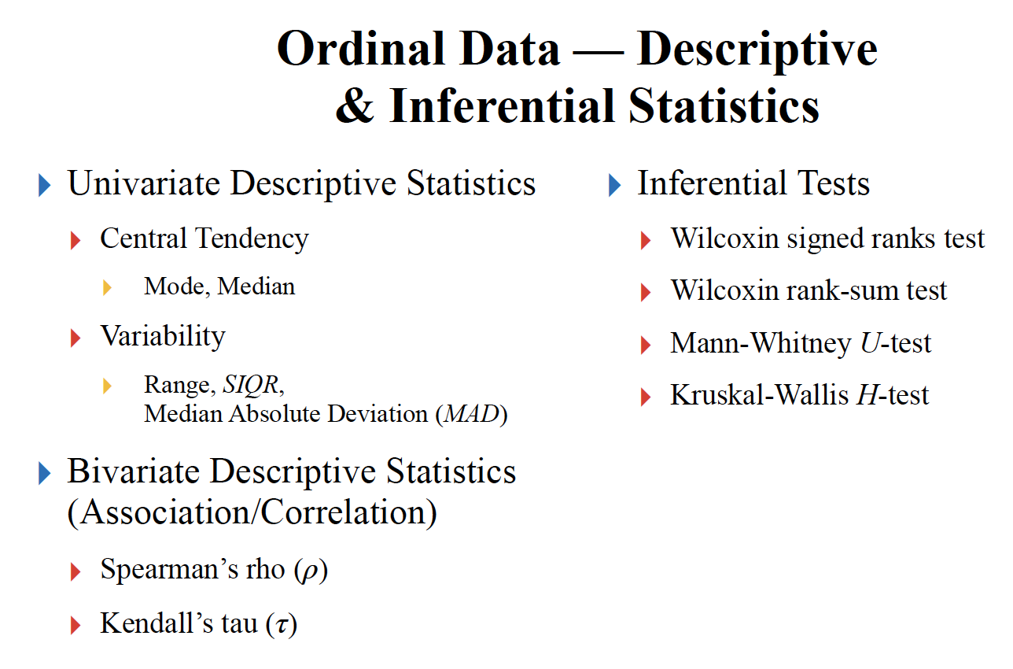
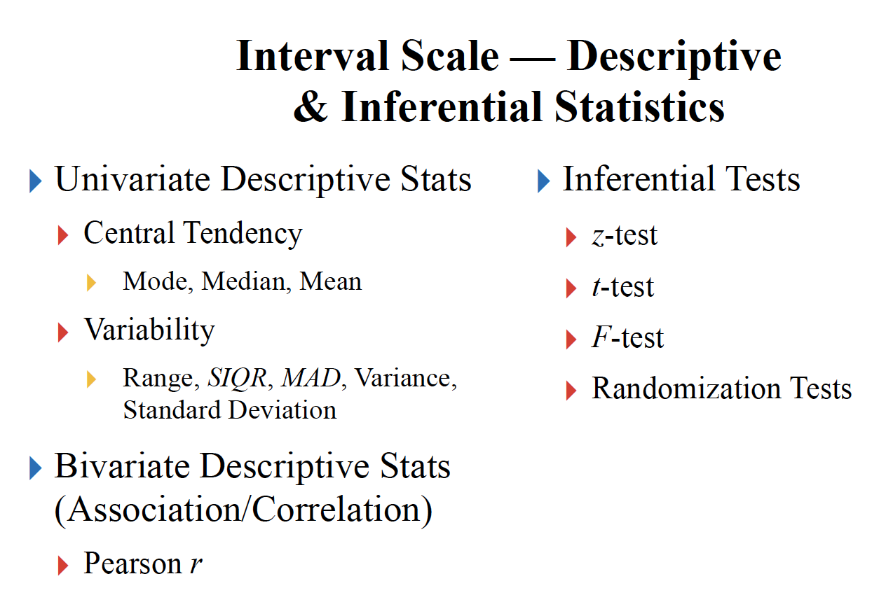
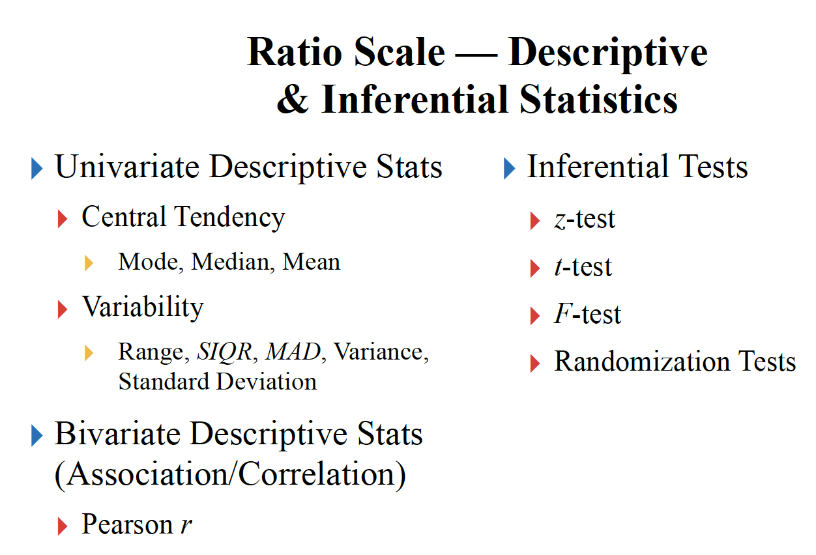
You do not need to learn this slide

Slide 39
Extra Resources

Slide 40
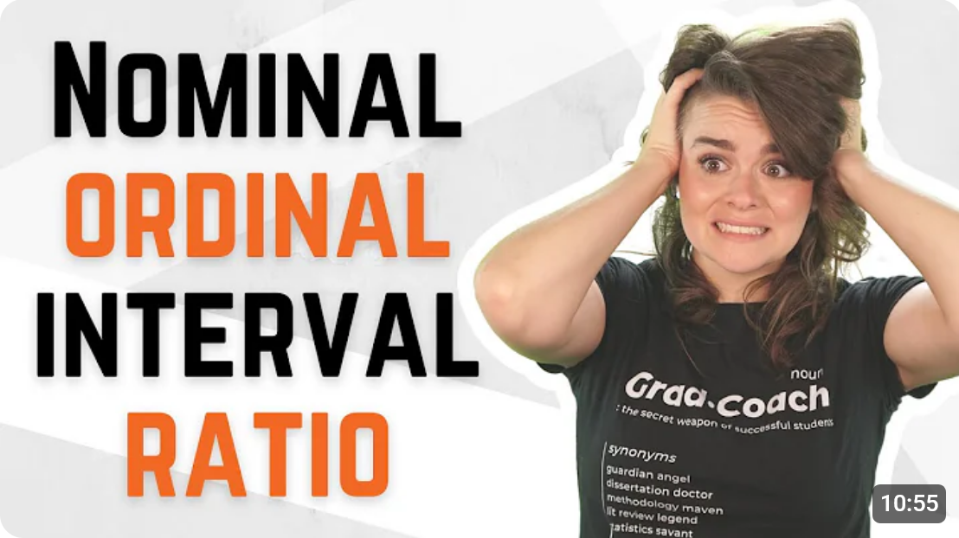
Extra Resources

